Slide 1
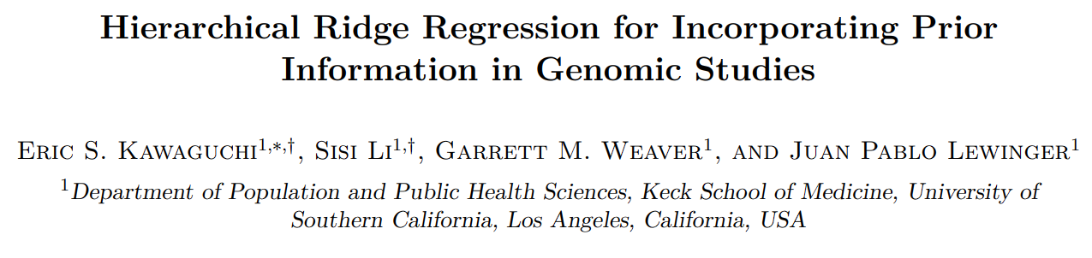
Reporter: Cheng-Hsuan, Wu

Slide 2
Outline
Motivation
Tech
2 level regularization
Reformulation
Result
Behavior
Simulated performance evaluated by R²
Simulated performance evaluated by AUC
Performance on real data

Slide 3
Motivation
Genomic data are often high-dimensional
more features per observation than observations
Classical regression can not capture high-dimensional features
require regularization, which adds penalty for regression coefficient
ie. ridge regression, LASSO, elastic net
Need balance between model complexity and model stability
Penalize all regression coefficients unequally, which is picking meta feature
Some use prime knowledge, but not accurate
Some use adaptively estimate these weights, but limit the num of meta features, and this assume that the meta features are explaining variations in the features
Need new method to extract meta feature
Use adaptive meta feature choosing
Directly use meta feature to evaluate the effect on result

Slide 4
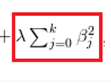

Background_Ridge regression
To solve regression model in case model too complicated
Add penalty terms to loss function
Especially suitable for low dimensional model
Lasso: penalty terms is absolute value weight

Slide 5



Tech_2 level regularization
second term is a ridge penalty that shrinks the estimates of β toward some feature-specific mean
when γ = 0, (3) reduces to (2), and thus the standard ridge regression
XZ: meta feature γ: coefficient of meta feature
X: subjective feature, B: coefficient of subjective feature

Slide 6

Tech_2 level regularization
Can be extended to include penalties other than ridge
LASSO or elastic-net included
Believed to handle highly-correlated features

Slide 7

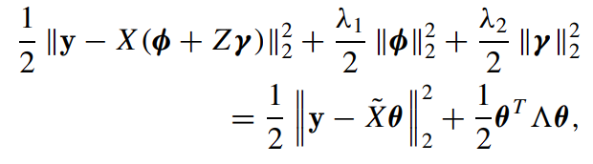

Tech_closed-form solution
use of warm starts
cyclic coordinate descent due to its efficiency

Slide 8
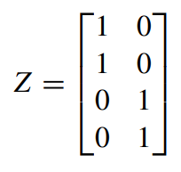
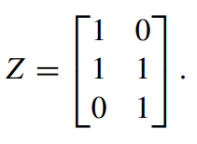
Result_Behavior
If Noncorrelated: Z: no two 1 in same colume
Conditions: Totally Noncorrelated, Pathway
For Pathway A,B: overlap or not
Use Z to represent external information
B^{ols}: weight from less square
B^{ridge}: weight after 1-level regression

Slide 9
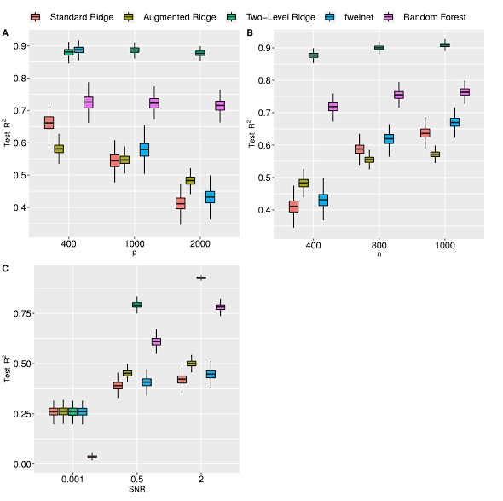
Result_performance evaluated by R²
Z is dicerect -> only 1 or 0
SNR: signal-to-noise ratio
p: Number of feature
Results are averaged over 500 Monte Carlo replications

Slide 10
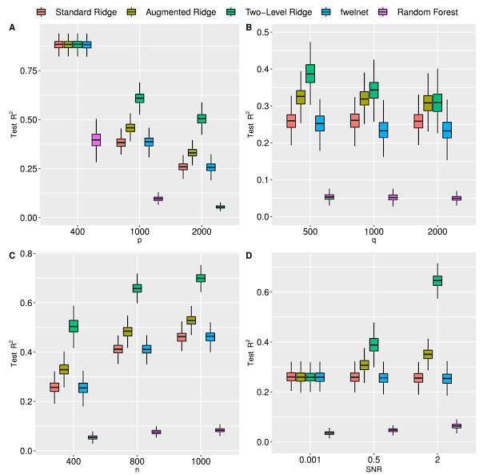
Result_performance evaluated by R²
Z is contiunous -> meta feature is continuous (multivariate normal density)
SNR: signal-to-noise ratio
p: Number of feature
q: Number of meta feature

Slide 11
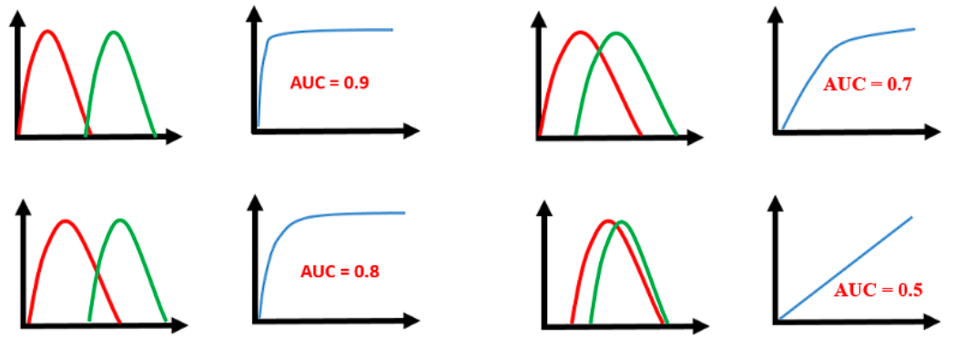
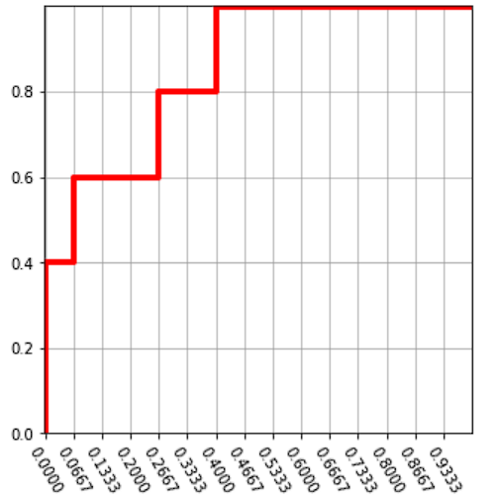
Result_AUROC
For 2 class classifaction (ie. death at specific timepoint)
given positive prediction softmax value
order data from big to small
if prediction gives positive, goes up; else goes right
caculate area under curve
The more significant the classification, the bigger the area

Slide 12
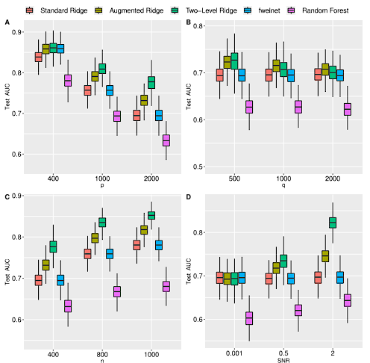
Result_performance evaluated by AUC
Setting same as previous
evaluate by AUC

Slide 13
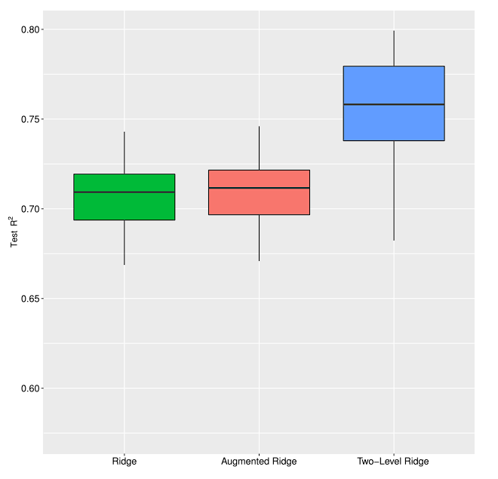
Result_Real data_epigentic clock
656 observations, test ratio=0.2
250,000 features
Maps back to original gene
See if site in same gene
6,766 unique genes with an average of 33 probes per gene

Slide 14
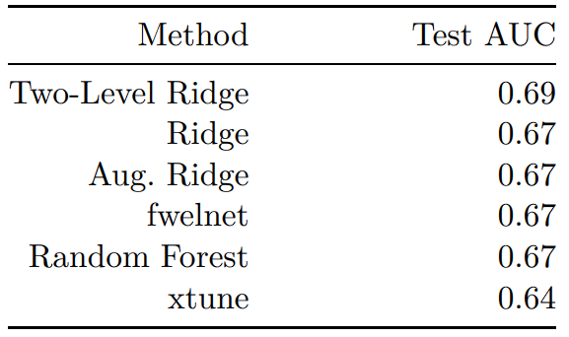
Result_Real data_Breast cancer
594 observations, 563 test
gene expression data, consisting of 29, 477 probes
Use Clinical research of meta gene signature generate 29, 477 × 4 matrix
CIN, MES, LYM, and FGD3-SUSD3

Slide 15
Disscussion
Pros
Simple models, Calculation easy
Perform better than other simple models
Cons
Need Z as prime knowledge
Prime knowledge need transform
Maynot exceed complex model performance

